Slide 1
MetroMetric
Can We Improve Transit Through Data Science?
Austin Brown ~ 3/16/2014 ~ DAT4

Slide 2
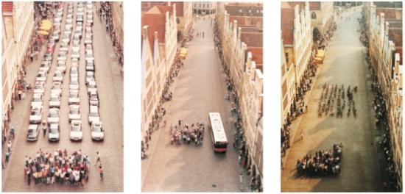
Buses Are Great
(But a pain to use)
http://www.howwedrive.com/2010/06/28/german-efficiency/
Münster

Slide 3
Background
Bus system economics, congestion reduction, and energy benefits depend directly on ridership
All buses in Washington Metro Area Transit Authority (WMATA) are tracked by GPS, with information available by API
Bus arrival predictions are available real-time through the website and another API
Good bus predictions are likely to improve ridership and user satisfaction
Bad bus predictions are certain to frustrate potential riders

Slide 4
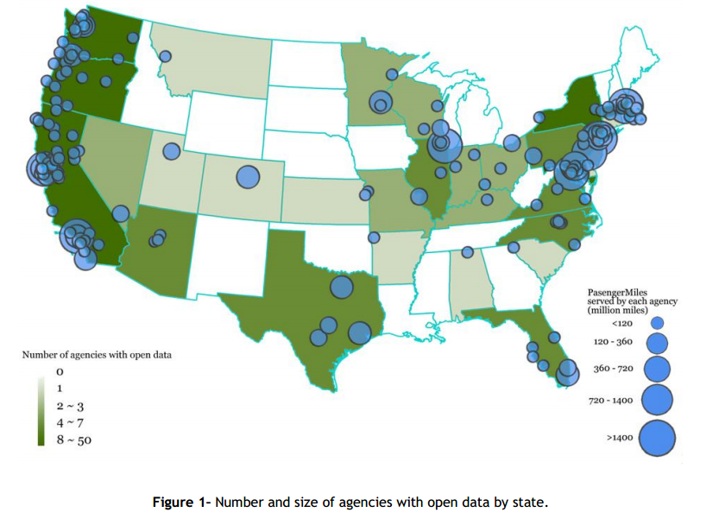
Open Transit Data
Illustration from http://www.prism.gatech.edu/~lreed3/opendata.pdf

Slide 5
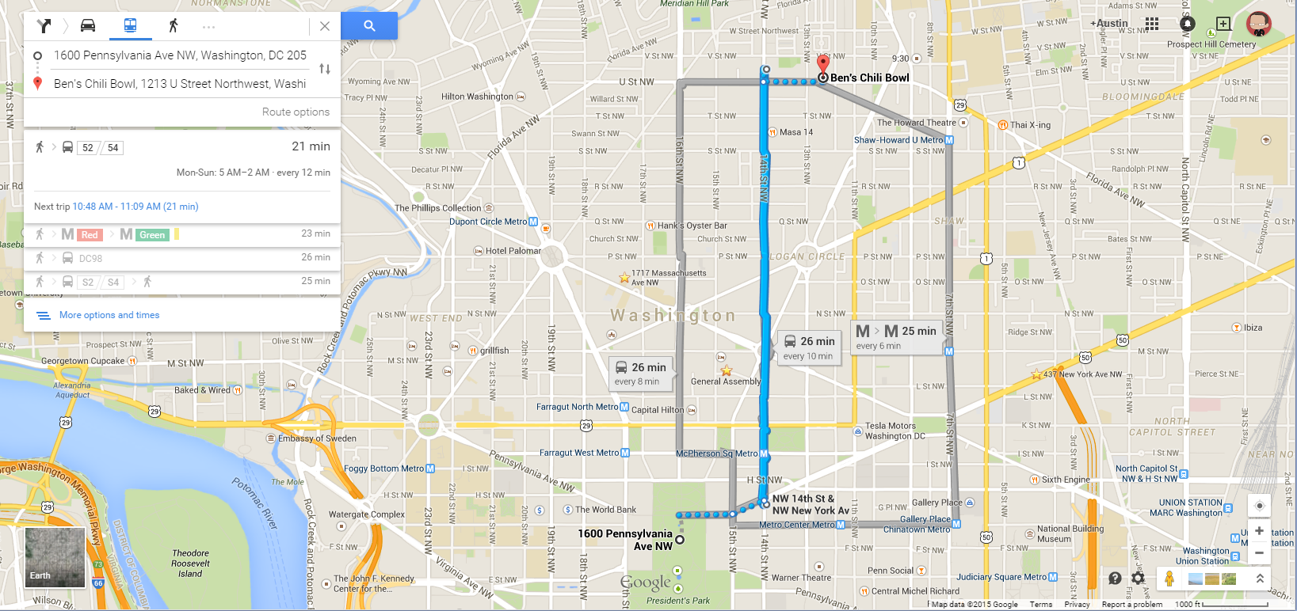
Example Application

Slide 6
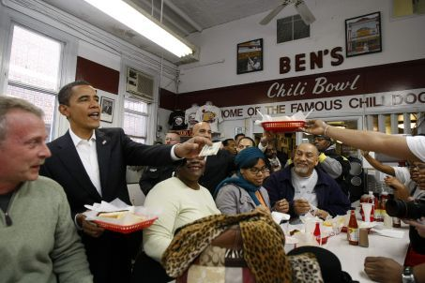
Example Application

Slide 7
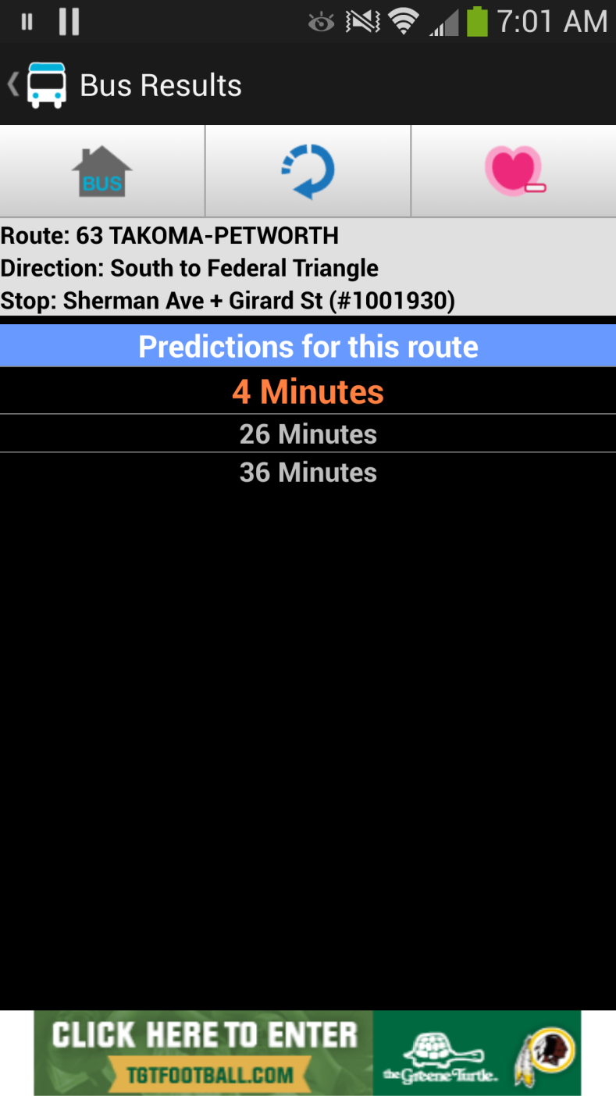
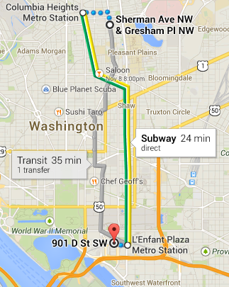
Personal Example
DC Metro Transit ap
Google Maps

Slide 8
When NextBus Goes Wrong
A bad prediction can be worse than no prediction
Especially early on, next bus was littered with “ghost” buses, and predictions seemed problematic
The NextBus algorithm is proprietary so the data community can’t work on improving it directly

Slide 9
Question
How good are NextBus predictions?
Can we mash up NextBus with other data to improve predictions?

Slide 10
Data Structure Concept
Field(s) | Description | Source
Route, Direction | e.g. 70 | Route API
StopID, Lat, Lon | Stop Itentified and location | Route API
BusID, Lat, Lon | Bus Identified and location | BusLocation API
Deviation | How far behind the bus says it is | BusLocation API
TripID | Unique trip identifier | BusLocation / Nextbus API
Time / Date | Time the prediction was made | Datetime package
Weather / Temp | Reported weather | Openweathermap API
Predicted Arrival | In minutes, when the bus should arrive | NextBus API
Actual Arrival | In minutes, how long from the prediction the bus arrived | Calculated
The basic data unit is one prediction. Data collection is done from four APIs in real time and stored in a data frame / csv

Slide 11
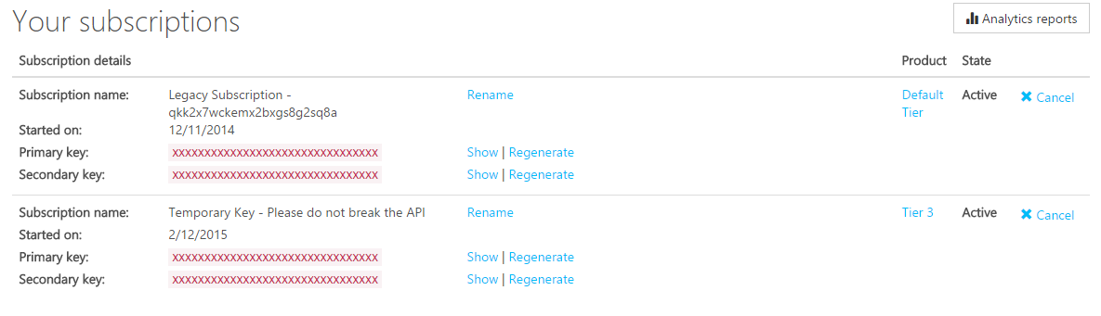
WMATA API Key
I need a lot of calls… WMATA to the rescue

Slide 12
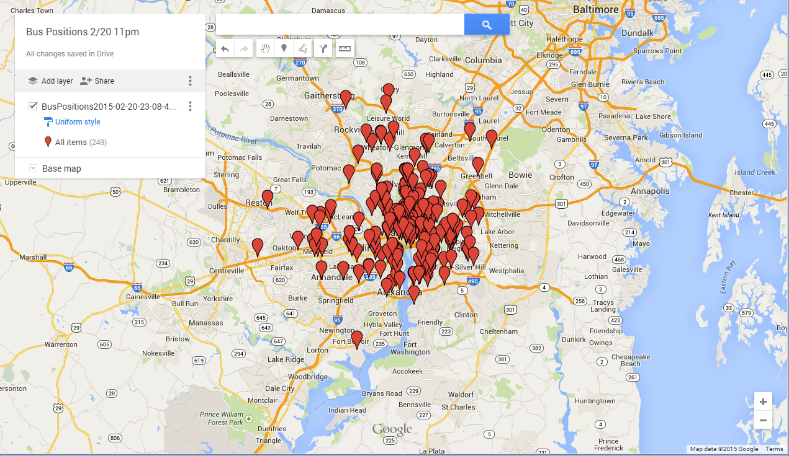
WMATA APIs – Bus Positions
One data call for all bus positions. 249 buses in system (at 11 pm)

Slide 13
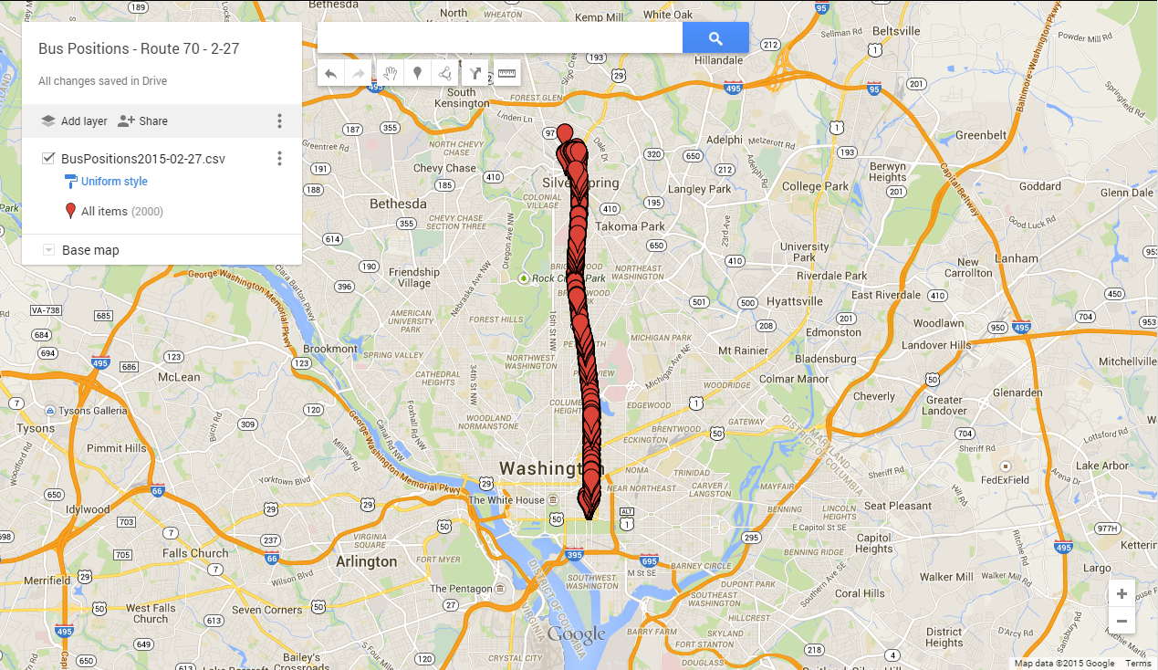
WMATA APIs – Bus Positions
Many data calls for route 70 only

Slide 14
Data Collection Overview
Days collected:
3/5, snow day, 5 am to 3 pm, with some data gaps
3/8, Saturday, 8:30 pm to midnight
3/9, Sunday, 5 am to 10:45
3/10, Monday, 5 am to 8:30 am
3/12, 7:30 am to 5:45 pm
Frame Size
500,000 future predictions, 10,000 arrivals
~100 MB on disk as csv

Slide 15
Method: Estimating Arrivals
After I have a big database of predictions, identify arrivals
2 possible methods
Predicted arrival = 0 minutes
Lat/Lon check
Pull the “predictions” where the bus has arrived and join that data frame to the predictions to assign the correct arrival time for each prediction
In my test data, covers 99% of all predictions
The ‘Error’ is the difference between predicted arrival and actual arrival

Slide 16
A “Quality” Metric For Predictions
Attempted to be reflective of our expectations for a prediction:
<1 is “perfect”, far off = sucky.
Should be more forgiving for further outCou be more critical of being wrong early (since you will miss the bus?
For this pass, I used [1 - |predicted – actual| / actual]
Predicted 2 minutes, actual 4 minutes = 0.5
Predicted 5 minutes, actual 7 minutes = 0.71
Predicted 10 minutes, actual 12 minutes = 0.83

Slide 17
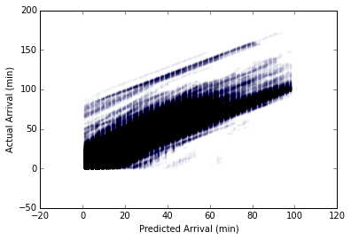
Results: NextBus Performance

Slide 18
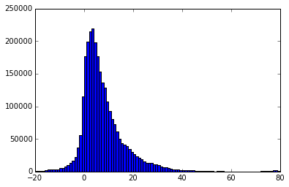
Results: NextBus Performance
All Predictions
Actual Arrival – Predicted Arrival (positive means the bus was later than predicted)

Slide 19
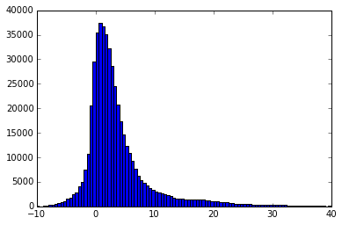
Results: NextBus Performance
Only predictions < 10 mins
Error (min)
Actual Arrival – Predicted Arrival (positive means the bus was later than predicted)

Slide 20
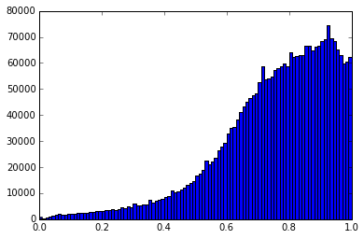
“Quality” Metric
mean 0.641955
std 3.706173
min -1198.000000
25% 0.647815
50% 0.782870
75% 0.893502
max 1.000000
Quality
Recall 0.5 means it was as far off as the total time the bus took to arrive. About half of predictions are better than 0.8, meaning ~ within 20%

Slide 21
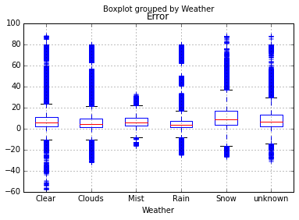
Results: NextBus Performance
Some evidence (from one day!) that snow increases error

Slide 22
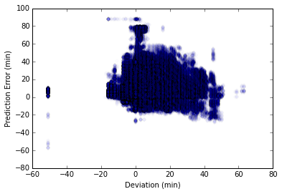
Results: NextBus Performance
Lateness looks like somewhat of a predictor of more lateness

Slide 23
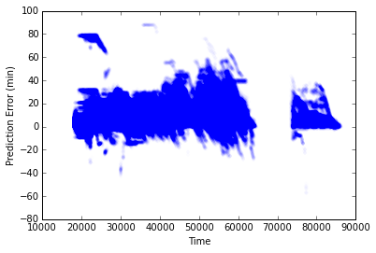
Results: NextBus Performance

Slide 24
Regression To Improve Predictions
Variables considered
Predicted Arrival (hopefully this will be the major predictor!)
Deviation (how late the bus is reporting itself to be)
Weather (text descriptor, created dummy variable)
Time (for now, as a linear variable… non-ideal)

Slide 25
Regression Results
On all data:
Predicted arrival: 1.107 (predictions high by 10% on average)
Deviation: -0.0007
BadWeather: 1.028 (on average rain / snow increase error)
Time: 0.0002
R² = 0.836 (same when done w/ train-test-split)

Slide 26
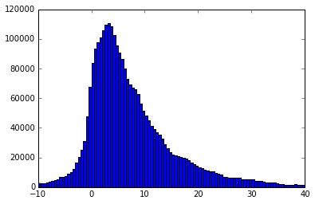
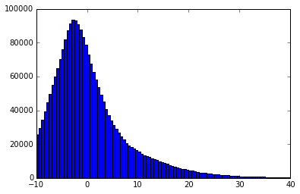
Regression Results
Raw
Not really an improvement, seems to fix one problem and cause another
Linear Regression

Slide 27
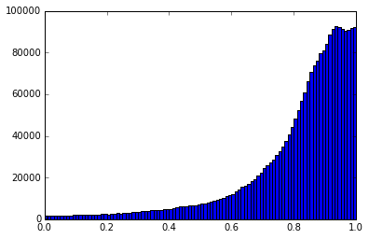
Regression Results
Raw
On quality metric, looks better – but I think this means my quality metric isn’t great…
Linear Regression

Slide 28
Improvement: Training Variables
Try:
Time of day dummy variables (rush hour?)
Day of week
Bus ID (as a proxy for driver)
Temperature (another proxy for weather?)
Location / stop ID (downtown?)

Slide 29
Other Next Steps
More complete data collection
More routes
All stops
Consistent time coverage
Use WMATA Incident API to explore effect of reported incidents on bus arrival predictions
Better optimization functions / other algorithms besides linear regression
e.g. Lasso to reduce useless features, or random forests to divide by classes (rush hour, weather, etc)
Explore outlier buses – is there an algorithm to identify errors in real time?
Fun stuff like animated maps

Slide 30

Thank You!

Slide 32
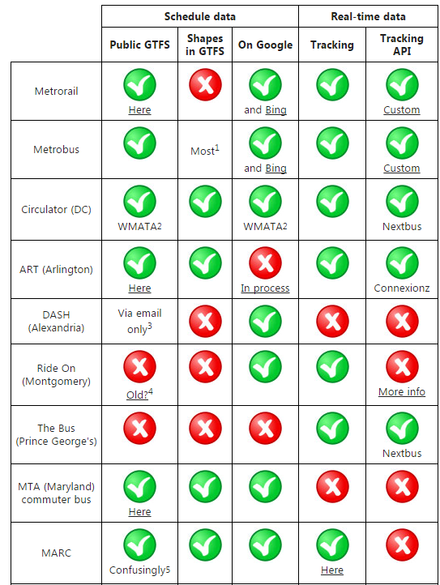
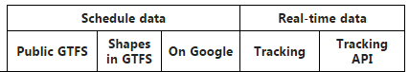
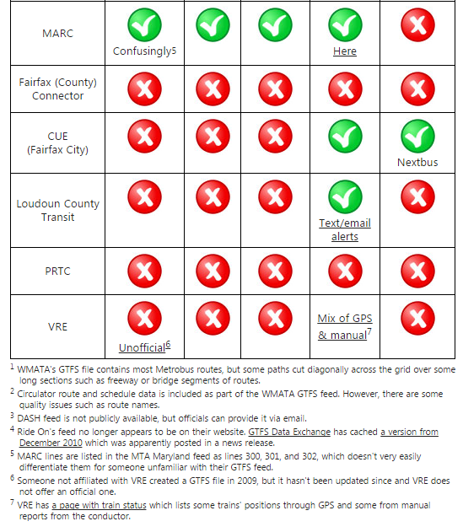
DC Transit Agencies Status (2012)

Slide 33
Notes
GTFS: General Transit Feed Specification (originally Google)
GTFS feed is composed of a series of text files collected in a ZIP file. Each file models a particular aspect of transit information: stops, routes, trips, and other schedule data.
Routes can include shapeform coordinates

Slide 34
APIs Used
WMATA Route Structure
To get list and lat / lon of stops
WMATA Bus Position
To get list and lat / lon of buses, as well as ‘deviation’
WMATA NextBus Predictions
To get predicted arrivals for each stop
OpenWeatherMap

